Slide 1
Measuring the Effect of Culture on Usage of Encrypted Communication in India
Ashish Gokarnkar
18IM30027
Nandini Bajaj
18CY20020

Slide 2
Introduction
Considered Instant Messaging as the mode for encrypted communication
Effect of culture can be measured through the social influence variable on user acceptance

Slide 3
Research Questions
What is the relative impact of social influence compared to others on the usage of encrypted communication systems?
Is the impact of social influence on the usage of encrypted communication systems correlated to the different variables of culture?

Slide 4
Hypotheses
Social influence has the highest impact on the usage of encrypted communication when compared to effort expectancy, performance expectancy, facilitating conditions’ influence.
There exists a very high correlation between Social influence on the usage of encrypted communication and the cultural dimension of Individualism-Collectivism, where collectivistic people stipulate strong social influence.
Measure of Uncertainty avoidance is directly proportional to the usage of encrypted communication.

Slide 5










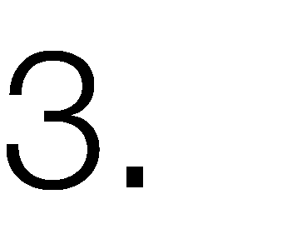





UTAUT Model [Ventakesh et al., 2003]
Study Methodology

Slide 6
Measuring Culture [Hofstede, 1991, 1993, 2001, 2003]
Study Methodology
Target Region = INDIA
Demographics = CROSS – CULTURAL Research principles
Hofstede’s 5 – dimensional framework
Power Distance
Uncertainty Avoidance
Individualism – Collectivism
Masculinity – Femineity
Time Orientation

Slide 7
Pilot Survey
Draft related Work Section
Consent + Demographics 6 questions
UTAUT 15 questions
WhatsApp v/s Facebook Messenger
Ease, Security, Social Influence
Culture 18 questions
(cross verified, cited, acknowledged)
Vas Taras, Julie Rowney, Piers Steel, Half a century of measuring culture: Review of approaches, challenges, and limitations based on the analysis of 121 instruments for quantifying culture. Journal of International Management.
Hofstede, G. (2011). Dimensionalizing Cultures: The Hofstede Model in Context. Online Readings in Psychology and Culture.
Stull, James B. and Von Till, Beth. Hofstede's Dimensions of Culture as Measurements of Student Ethnocentrism: A Quasi-Experimental Study. Distributed by ERIC Clearinghouse [Washington, D.C.]

Slide 8









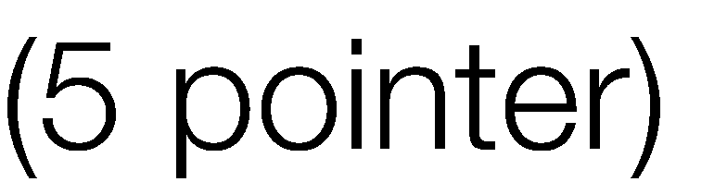

Measurement Metrics
Draft related Work Section
•
•
•
o o o
✓
✓
✓
Ratings
}
UTAUT
Scenarios
Ranking
CULTURE

Slide 9
Risk Mitigation - Culture
Draft related Work Section
Extreme response bias: Systematic tendency to over express agreement or disagreement by choosing anchors towards the ends
Acquiescence bias: promptness to agreement
Solutions
Inverted both anchors while framing questions
Within-subject standardization [Hofstede, 2001]

Slide 10
Observations & Results
WhatsApp is majorly the preferred messaging app in India in all sorts of situations for users from all a variety of demographics.
The user affiliation towards WhatsApp is found to be so strong, that understanding user’s preference towards encrypted communication based on privacy needs is very cumbersome.
Participants with lack of knowledge in fields of encryption were forgetful of its definition explained in the beginning. Hence, questions related to encryption in the later parts received indifferent responses.

Slide 11
Observations & Results
4. It’s extremely tough to gauge privacy concerns of users as their choices are heavily influenced by social impact. However, when presented with a threat model, their concerns come to light.
5. For a few questions, answers constructed didn’t cover all the categories of the audience that were supposed to be interacted. These questions have been modified accordingly for the final survey instrument and listed later in the presentation.

Slide 12
Improvements
A qualitative question has been added to our survey to analyze if the audience has had the same preferred app since the start or did, they switch to a different app sometime during their use. In case they switched to a different app, to gain insights on why this shift happened and what was the reason to choose the latter app have been proposed.
Arrangements for conduction of online interviews to get qualitative data to gauge the choice made by users between usability and privacy & security. The reason to conduct interviews for this aspect is because measuring privacy concerns over quantitative survey questions was realized to be tough and ambiguous.
Added encryption descriptions and video

Slide 13
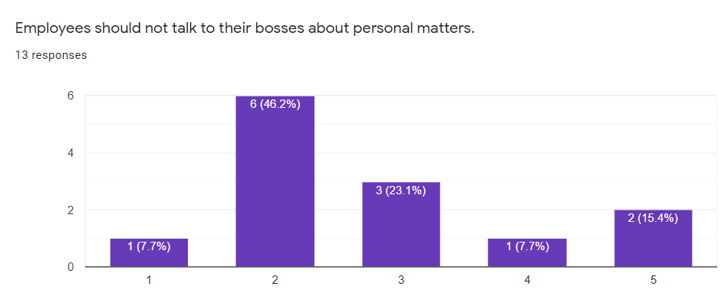
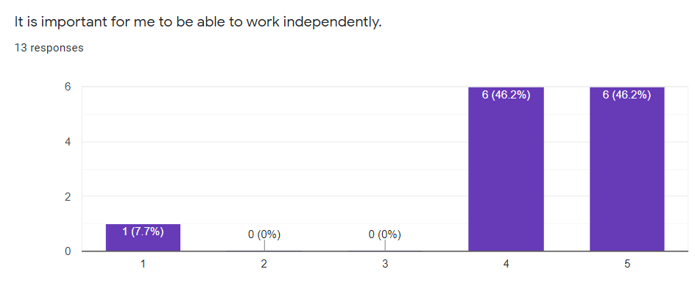
Current Work
Data Analysis
Cronbach’s alpha: To reduce number of culture questions (18 → 9). Generate Max (Distribution)
Within Subject Standardization: Weight allocation and finalization of questions
Weights – Taras et al., 2009

Slide 14
Current Work
Data Analysis
Spearman’s Rank Coefficient: To find inter relations between constructs of UTAUT, relations between Culture and questions of UTAUT
χ² test: For correlations between demographics (age) & Culture Variables, Culture Variables and selected Individual UTAUT Questions

